Slide 1
Camera Rollette
Lo-Fi Prototype
Faraz Fadavi

Slide 2
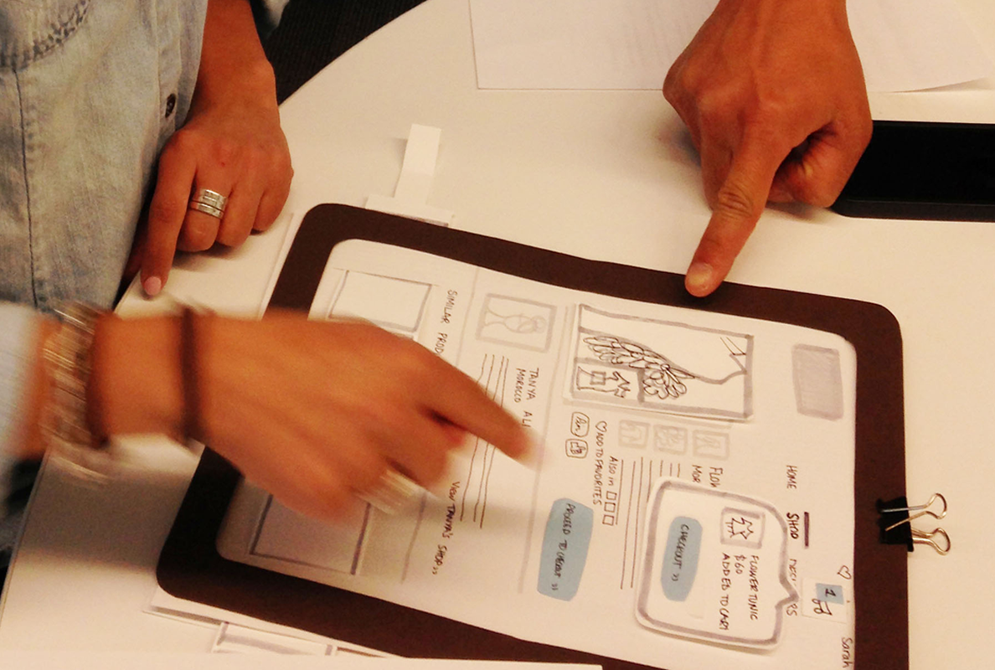
Overview of Talk
Notes:
Today I am going to talk about lo-fi prototype testing for camera rollette
Our mission statement and value proposition
Our design process and narrowing down our choices
Key tasks we wanted our testers to achieve
The way we went about our expermental method
And results and changes we arrived to from our tests

Slide 3
Mission Statement
Value Proposition
Bring friends together to have a fun time looking back at past experiences
Enjoy your best memories, together
Notes:
People do not have an enjoyable and acceptable means of looking back at past experiences with friends and having fun while doing so. As a result, we designed a collaborative game that allows individuals to come together and have a fun time looking back at past experiences in photos. We want our users to enjoy their best memories together with their friends.

Slide 4
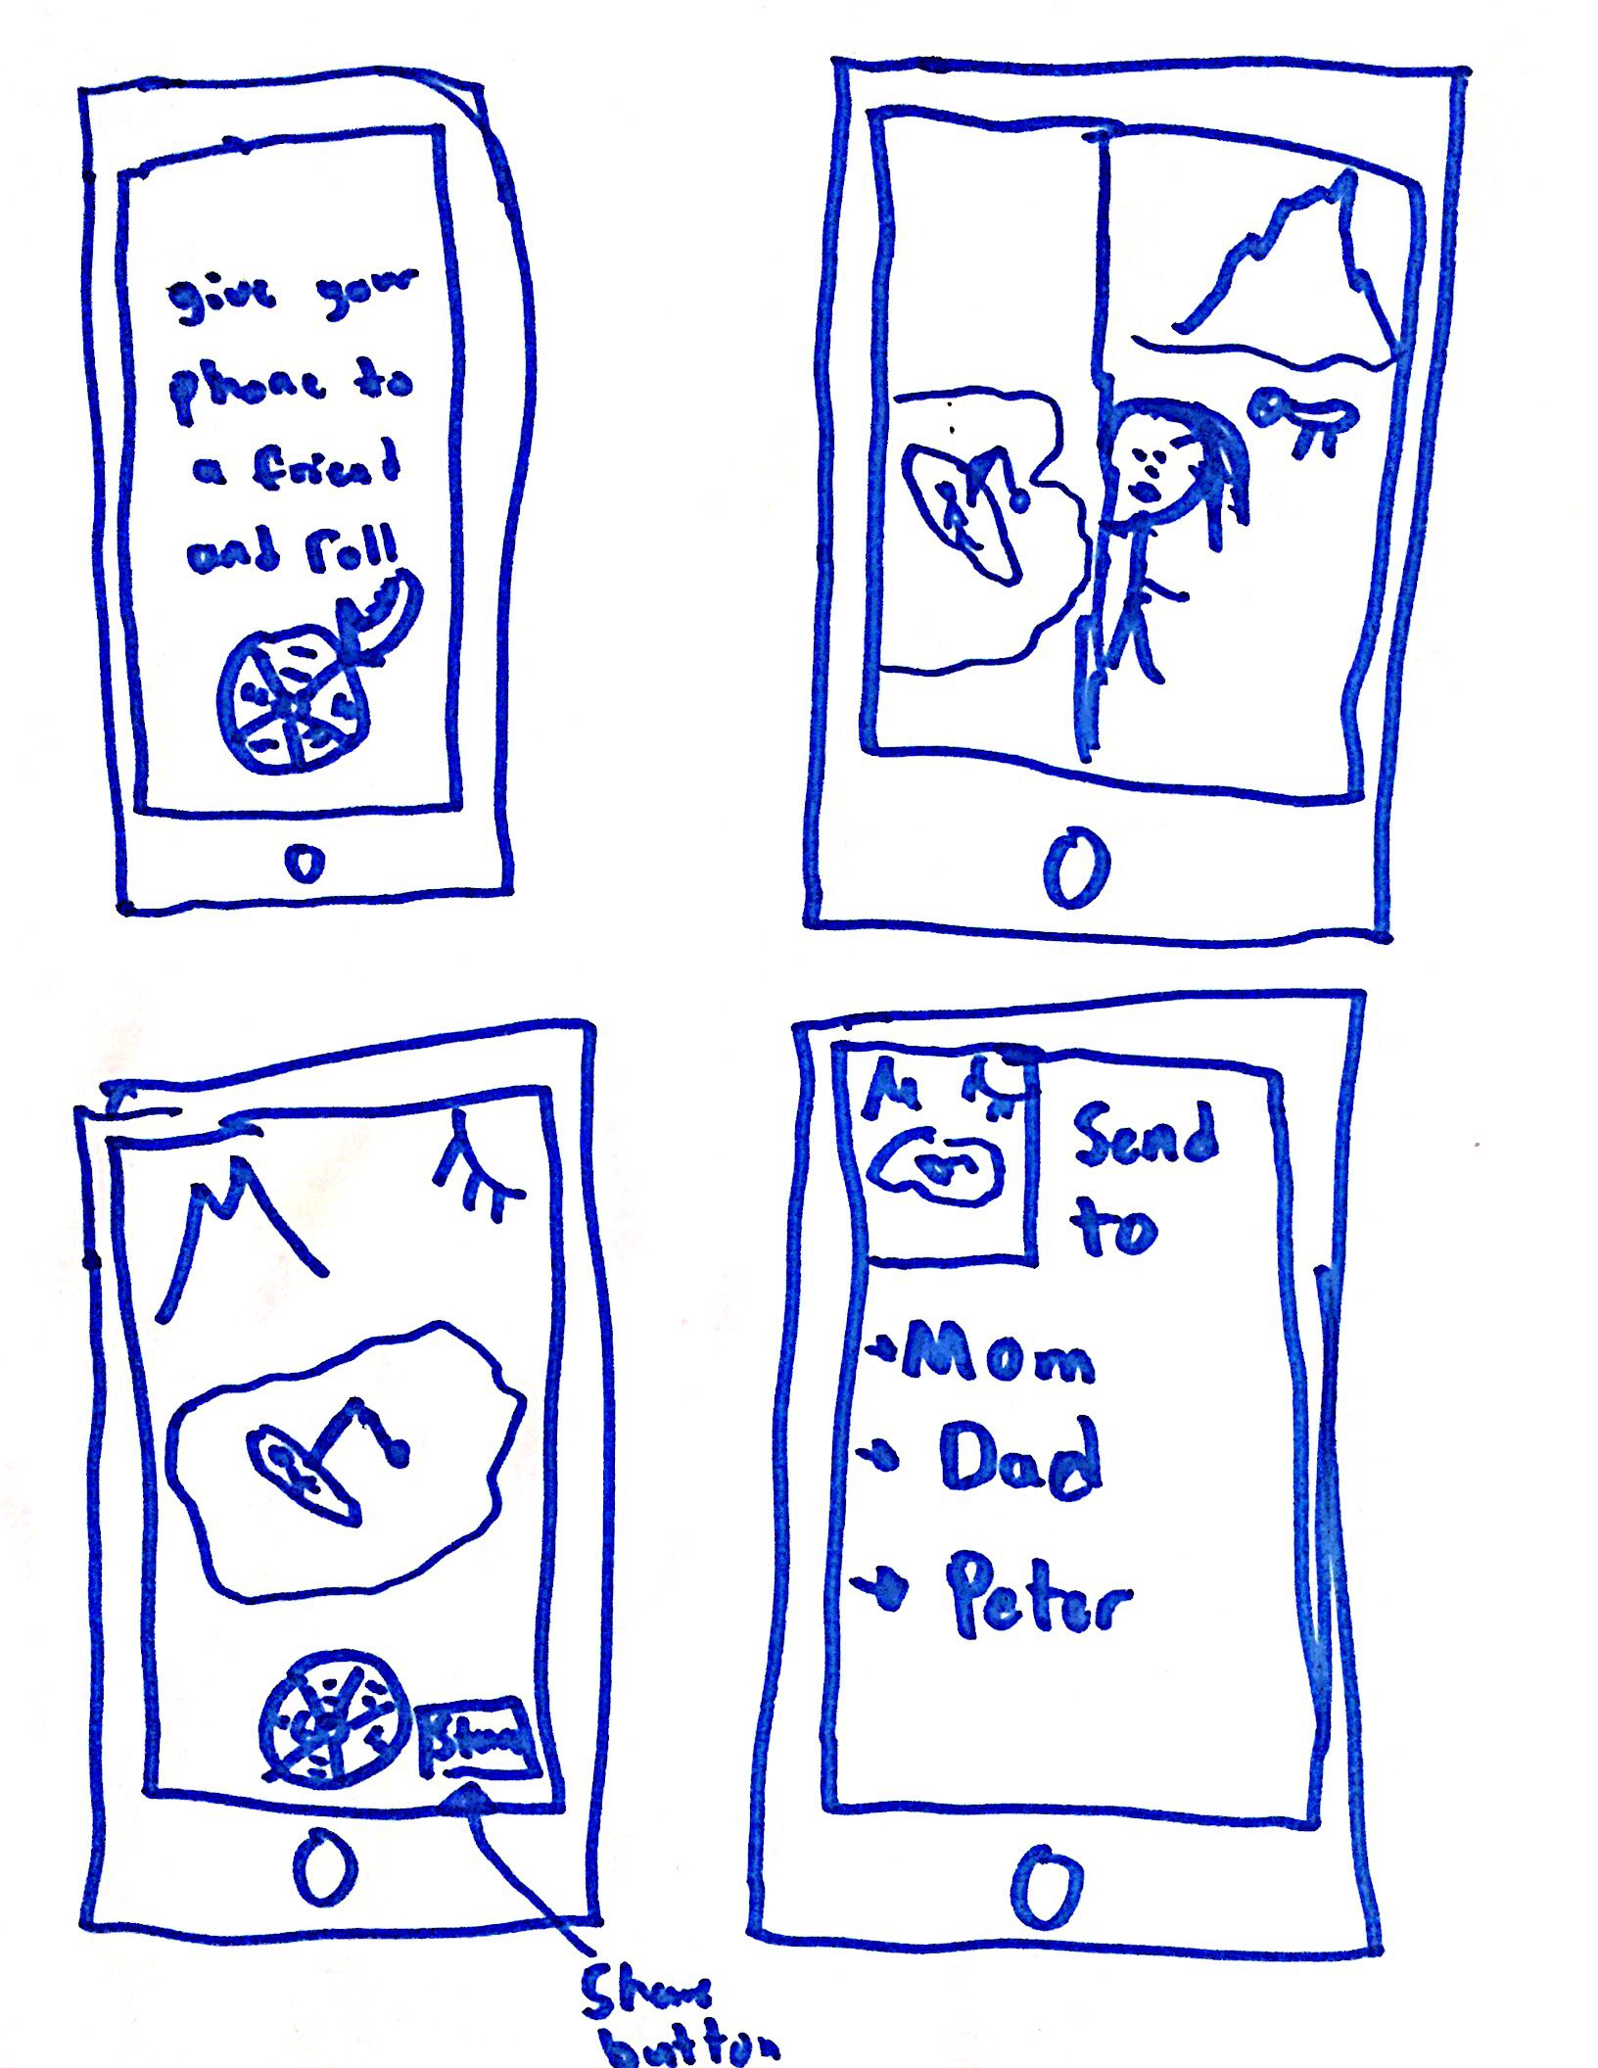
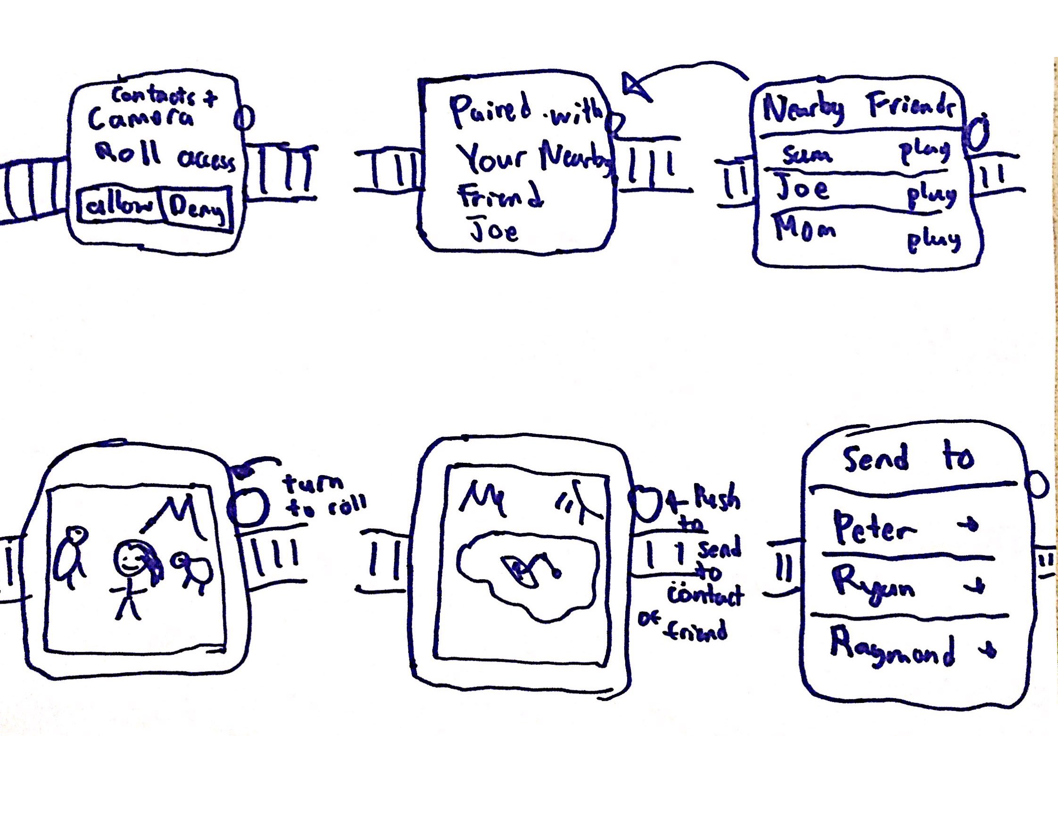
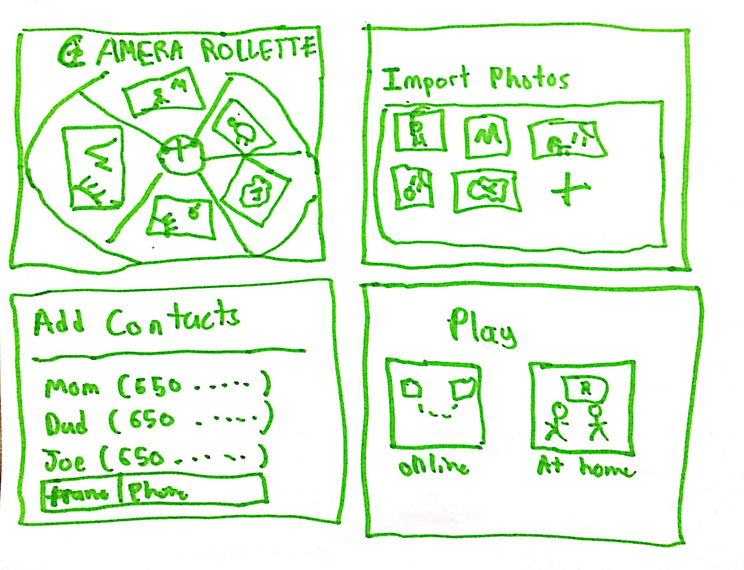
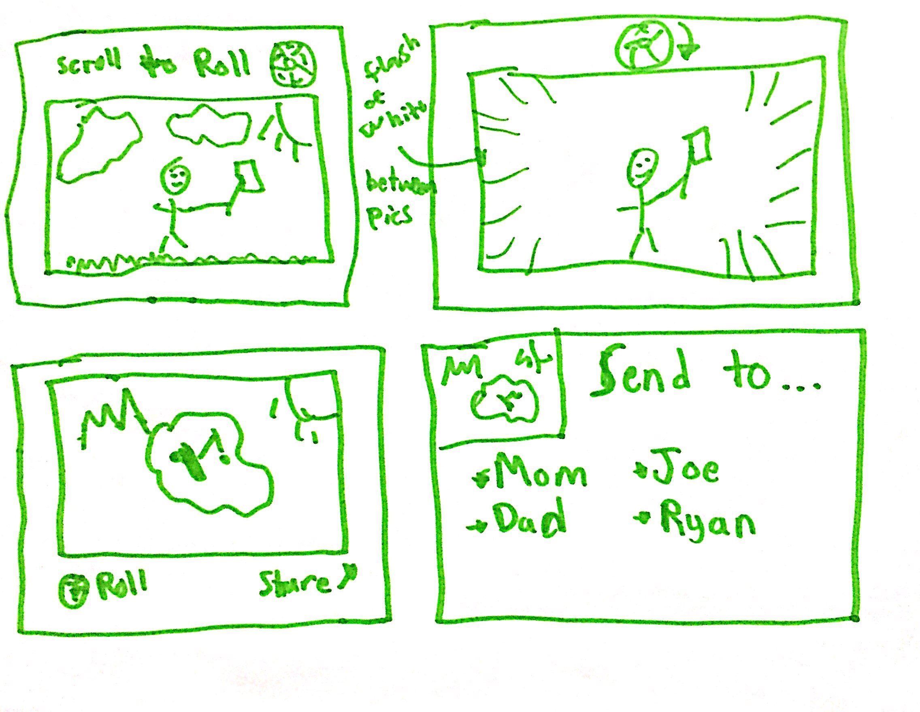
Smartphone
Smartwatch
Web App
Notes:
We had three different design philosophies: a smartwatch app, a smartphone app, and a web app.
We chose the smartphone app and the smartwatch app as our top two designs. The web app requires users to upload photos from their desktop onto our servers, which may give users privacy concerns. Additionally, smartphones and smartwatches allow for natural twists with the screen or crown that give an intuitive feel to the rollette process.
We aimed to remove as much clutter as possible from the screen and to display, as prominently as possible, the pictures that the user would scroll through or the network he/she would be searching through. Since smartwatches live on people's wrists and are awkward to take off to show people, we allowed the users to pair with nearby friends via bluetooth to play the game by exchange photos via the fast bluetooth. We utilized the crown for rolling through pictures and for sharing with friends or on social media. We believe that this significantly reduces the on screen clutter. The drawbacks with this design are that the watch does not always naturally have a camera roll filled with pictures however it can be sent in from the phone. As well, smartwatch screens are small and therefore difficult to view pictures on. Finally, smartwatches can not be smoothly passed between people.
Most people have a plethora of unused and unseen photos on their camera roll that would make for great laughs and experiences for viewing with friends. As well, smartphones have the screen size users typically see their photos on, which makes it a natural fit. The drawbacks with this design is that the natural twisting of the crown in the smartwatch are lost on this device, however it is somewhat made up for by a natural swipe across the screen. As well, the photos are being viewed on a small screen as compared to a web app version that can take advantage of a full laptop/desktop screen.

Slide 5
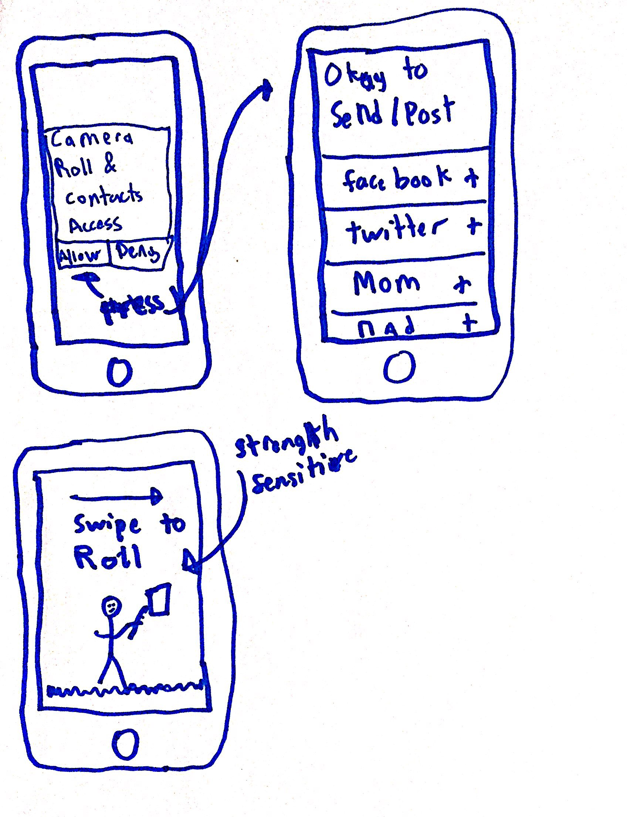
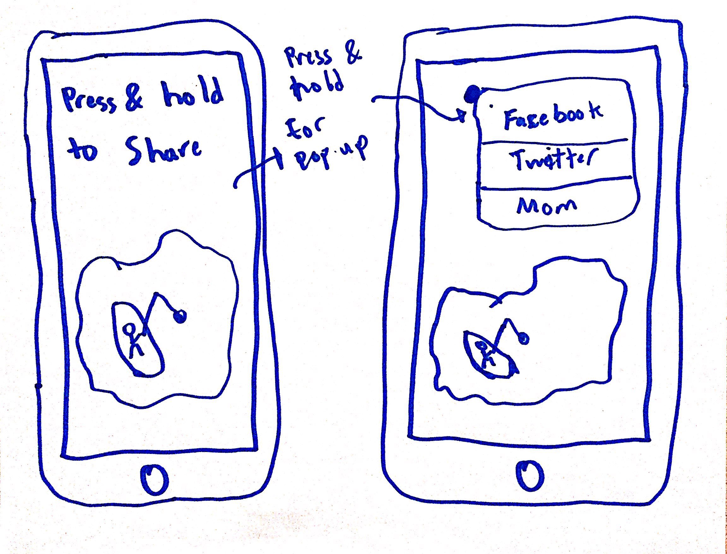
Smartphone App
Notes:
Reasoning for Selection
We believe smartphone interface is best due to several factors:
Everybody in the modern age has a smartphone, this is not the case for the smartwatch.
The smartphone is portable, therefore permitting users to play Camera Rollette on the fly.
All individuals have their pictures saved on their smartphone, which is not the case for their other devices.
The smartphone screen size is perfect for visualizing the photos and for swiping. Additionally, the smartphone screen allows other individuals to watch as someone plays Camera Rollette.
Individuals have their contacts saved to their smartphone and it is easy to provide access, which is well suited for the Camera Rollette sending functionality.

Slide 6
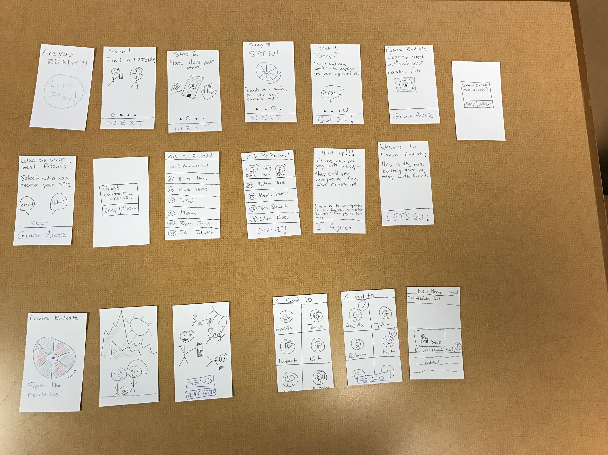
Lo-Fi Prototype
Task 1
Task 2
Task 3
Notes:
When creating a lo-fi prototype we capture the essence of our app:
Play a fun game in the presence of friends
Reminisce on past memories by looking back at random photos in the camera roll
Invite other friends to join and play and expand your circle
We had three key tasks that we wanted to test with participants

Slide 7
Task 1
Setup the game to import your photos and pick your close friends
Notes:
The first task was opening up the game and setting it up in order for it to be ready to play. This involved the initial screen that is first displayed when the application is opened, the tutorial, granting the application access to photos and contacts and setting up the trusted list of contacts that can receive photos through the game.

Slide 8
Task 2
Play the game by rolling to a random photo
Notes:
The second task was to play the game. Here the user had to flick the roulette and spinning through funny pictures that we provided and then land on a screen where they can either play again or send a picture to a friend.

Slide 9
Task 3
Share the photo you like with one of your friend’s contacts
Notes:
The final task was sending the photo to a friend or friends. This involved going through a list of friends and picking the ones to whom the user wants to send the photo and then moving into a messenger screen to send the photo in a message.

Slide 10
Experimental Method
Demo app
Set each task’s scene
Assess performance
Iterate
Notes:
We designed our prototype such that the other friend was not necessary and only one individual was sufficient. We began by having Abdulla introduce the participants to the app
Then, as part of our set script, Abdulla set up each of task that the users had to accomplish through our UI, while Ryan would change out the scenes according to the interactions
I assessed the user’s performance in three main areas
Locations of confusion when using the product: we tested this by looking for pauses or when the user asked what they were supposed to do next.
If there was any excess or missing functionality: we tested this while the user was using the demo and they said that they felt they did not need something or that they ‘wish’ they could have something else. We also asked them about this after they finished with the demo.
Enjoyment and likelihood to share the product: this was tested at the end of the demo by asking the testers their thoughts, perceptions and who they would share it with if anyone.
Finally, we iterated this process over three tests with four individuals

Slide 11
Nick & Jackson
Notes:
Nick and Jackson are two high school students from Los Angeles.

Slide 12
Result
Changes
Found idea of not picking your own photos “unnerving”
Had trouble figuring out how to move to next page
Asked us to send them invite to the app upon official launch
After granting access to photos ask if there are photos that the user does not want to show up
Have clear scroll methods and task descriptions
No changes, nice to hear!
Notes:
They found the onboarding process intuitive and understood that it was tutorial. They were not sure whether they picked photos or if photos were randomly picked. They expressed the desire to be able to choose which photos end up on the app and the others can see as they stated that they had extremely embarrassing photos on their camera roll. As well, we plan to have clear scroll methods and task descriptions for ease of use. As well, they expressed that they want us to let them know when the app launches officially so that they can play it with their friends.
The other problem we saw users face was with the photo picking and shuffling process. A lot of individuals felt that they had certain photos that were too embarrassing to share and wanted to remove those. We initially believed that this would remove the fun aspect of the game. However, we realized that individuals overwhelmingly stated that without that functionality they would not play the game. Therefore we will implement this feature and see how that affects the overall experience. Additionally, individuals did not know they were randomly flashing through photos using the roulette even though this is stated on a previous screen. Therefore, we can implement a feature that shows a short message stating the functionality of the roulette.

Slide 13
Friend Chaikulngamdee
Notes:
Friend recently graduated from Stanford and is now working at a research lab and is in the process of writing a book.

Slide 14
Result
Changes
Did not understand that she was undergoing a tutorial
viewed the onboarding process as “cheesy” and long
Wanted to send photo to every contact
Write the word tutorial onscreen
Explain that by flicking the roulette the app will randomly flash through photos
Allow send all functionality
Notes:
She said that she often scrolls through her camera roll to check out old photos and therefore understood and appreciated the Camera Rollette concept. Her initial reaction is that she did not understand that she was undergoing a tutorial when she first opened the application and asked for that to be more clear. She also viewed the onboarding process as “cheesy” and thought it should be shorter. She thought that the approved list was vague and did not understand what she was granting access to. She wished there was a quick summary of the app as the first line. She also wanted a functionality that could allow her to send the photos to everyone. Overall she enjoyed using the app but felt that there were improvement necessary before she would share it.
One of the largest perceived issues were with the tutorial process. Certain testers found it to be tedious but moreover some testers did not even know that they were undergoing a tutorial in the application. They thought that we had provided them with instructions on what to do right away rather than what was to come. We believe that a good fix to these would be to write onscreen that they undergoing a tutorial and shorten the tutorial screens to only one screen with far less playful words and fluff so as it make it more straightforward.

Slide 15
Genevieve Payzer
Notes:
Genevieve is a Stanford undergraduate who is currently undecided on which major she will pursue.

Slide 16
Result
Changes
Thought the tutorial was not clear and was confused
did not feel compelled to send pictures to others
Had no friend to send to in a contact list
Shorten tutorial process by having just one page with short info
Make sure a minimum of one friend is picked on initial friend access screen
Remove share button
Notes:
She told us that she does not go through her camera roll that often. As well, she thought that the tutorial was not clear and was confused about who can receive the pictures. She did not pick friends the app technically could not send pictures to the others, which is a functionality issue. Overall she thought the idea was interesting but would not share it with her friends. For her the tutorial was long and she believed that she had too many repetitive photos in her camera roll. She thought the game would be more fun with someone she did not know.
One major issue was when individuals skipped the friend picking process. When this occurs and the individual arrives to send the photo, there are no friends that appear. We had not initially thought of this problem. However, we deemed that there were two possible solutions to the problem. Either remove the send button if no photo is picked, however this removes the fun aspect of sending the photos for the player. Therefore, we thought of setting a minimum choice of one contact that can receive photos before moving forward but have to see if this is the best solution.

Slide 17
Summary
Enjoy your best memories with your friends
Three kinds of young people
Some tasks were intuitive (rolling a photo)
Some tasks were overly complex (onboarding)

Slide 18
Thanks
Questions

